Slide 1
Consensus Algorithms
in Blockchain
Mentor:
Assoc. Prof. Dr. Gökhan DALKILIÇ
Büşra Şafak Zırhlı
Student,
Dokuz Eylul University,
Faculty of Engineering

Slide 2
Abstract— This article describes how to implement proof of work from consensus algorithm types into blockchain in cryptology, simple and reliable application formats. In this application, java which is one of the object oriented programming languages is used. This document has been prepared in IEEEtran format.
Index-Terms —
Blockchain, Consensus Algorithm, Proof of Work, Object Oriented Programming, Java Programming Language

Slide 3
I.INTRODUCTION
Blockchain first appeared in bitcoin article on October 31, 2008. Blockchain is a distributed data logging system that allows tracking of encrypted transactions. We can't change and delete the data we saved so we can't think of blockchain as a database. Data is stored and shared by connecting them to each other by encryption algorithms such as a chain.
Consensus algorithms are algorithms that ensure the security and integrity of data on distributed systems and processes. The consensus algorithm provide a community to decide whether the transaction is authenticated and not authenticated. The same idea about the transactions made around the agreement. Consensus algorithms prevent double spending problems and make transactions in blockchain more reliable. Double spending problem is not in the hands of the hands of two people instead of sending copy of the original and experiencing this situation in financial events causes huge problems. Consensus algorithms are used to eliminate this kind of fraud and security problems. Consensus mechanisms enable the transfer between A and B in digital currencies and perform these transactions in a transparent and transparent manner.
People in this system need to validate transactions by solving blocks. The reward system has been developed to ensure that this is done in a regular and accurate manner. Consensus mechanisms reward members of the network when they resolve the block with newly created tokens in addition to the transaction fee for each transaction performed in the block. In this way, they will not only increase their own boilers but also make the network stronger. There are too many consensus algorithm types used in the blockchain structure. Some of these are as follows...

Slide 4
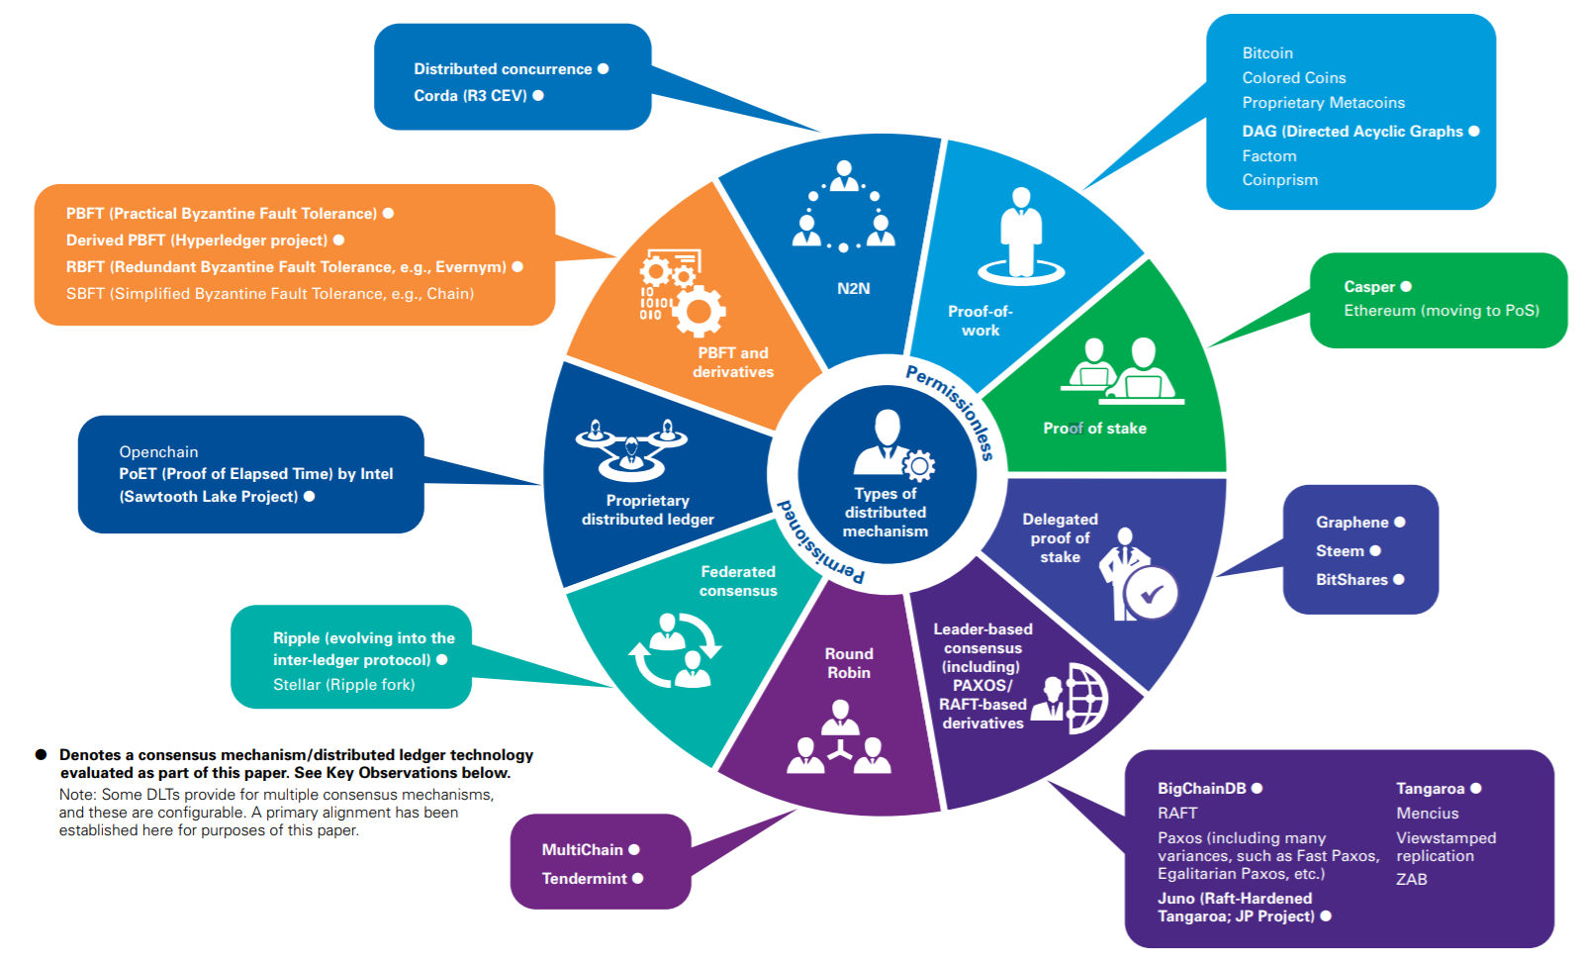
Different Types of Consensus Algorithms Infographic:
1- ) Proof -of- Work (PoW)
2- ) Proof -of- Stake (PoS)
3- ) Delegated Proof -of- Stake (DPoS)
4- ) Proof -of- Capacity
5- ) Proof -of- Authority

Slide 5
PROOF -of- WORK (PoW):
It is a consensus algorithm used in digital currencies of bitcoin and ethereum. It is a concept developed by Cynthia Dwork and Mani Noar.
In 2008, Nakamoto used this concept to verify the operations in the infrastructure of the bitcoin and add new blocks to the blokchain. It's easy to verify by everyone on the network, but hard to find. Once the miner has found the solution, he or she can publish the block to the network and other miners on the network verify the correctness of the solution. All verified blocks are named PoW because they contain a blockhash representing the work of the miners. (Miners should find a solution to add a new block to the chain.) Increasing the number of miners makes the network more secure. Due to the high amount of processing power and a high power protection against DDoS attacks. The attacker must attack the system with more force than the total processing power in order to achieve success. This leads to increased cost.
In PoW, too much time is needed to solve the calculation, which creates a disadvantage. In addition, these processes cause a large amount of energy consumption. That is why a single miner can make these calculations mean more cost. In short, PoW is extremely costly and leads to high energy consumption.

Slide 6
II. RELEATED WORKS
If PoW is a hash, the array should contain a scan of the value starting with '0' bit. The required operation can be verified by running a hash. The timestamp increases the gap in the network until it finds the required bit value on the hash of the block. Once the CPU is spent to fulfill processor proof, the block cannot be changed until the process is repeated. When adding new blocks, the block changing process involves repeating all subsequent blocks. The majority of the decision in business evidence can be attacked by people who can collect many IP addresses (one-CPU-one-vote). Reliable nodes control the power of the CPU(it allows fast and outward opening). In order to change the previous block, the attacker will have to capture and pass the operations of the trusted nodes after repeating the work of the block and all the blocks below it. The possibility of slow attacker is reduced as new blocks are added. If blocks are produced quickly, the difficulty of attack increases.[1]
Proof of work is also used in the bitcoin network. Calculates the hash values for each node. The logic of the consensus algorithm also indicates that the calculated value must be less than or equal to a certain value. The hash value is calculated until the value is reached. When the value is reached, its accuracy must be confirmed mutually. Encouragement is recommended as verification takes time. As new blocks are added to the block chain, it is very difficult to reverse the block chain to change operations. In Bitcoin, six blocks must be produced for the acceptance of the blockchain originality. Miners have designed PoW protocols to reduce energy loss in calculations. For example; Primeco's search for special prime number chains. PoW wants the miners to send the coins to the address they don't use. In this way, the chance to win, but does not need strong hardware.[2]
The necessary processes for the blocks to be produced are determined, and these processes are used to find the tree structure and root value of merkle. Block header root value, hash value of the previous block and nonce values are generated. Hashing checks the suitability of the value. If the hash value is successful to see if it is successful, it spreads. If not, the nonce value is increased. If it still cannot be created, the loop repeats.[3]
Cuckoo cycle randomly generated doublesided graphics from a message. It targets the loop, not the algorithm. The graph is generated by the message and indices in a certain range, so it is difficult to predict the result. Cuckoo cycle uses two different nonce values. For verification, both sides can determine very low probability for prover.[4]

Slide 7
III. STUDY AND SOFTWARE DESIGN
In this study we will use java, one of the OOP languages. (Java and JDKs must be installed.) We will use the GSON library to translate objects, but will also be used for peer2peer operations. We need to create the blockchain. The hash values are used as a digital signature. Calculating and comparing the hash values gives information about the presence of the blockchain.
SHA256 algorithm was used to perform these operations. SHA256 is a function developed by NSA for proof of work calculations and used to create bitcoin addresses. It is one of the most reliable crypto functions. It tries to synchronize data of different sizes and sizes (256 bits). The operations performed here are unidirectional, so the data is converted to the hash value, but the hash values are not converted to data.
Let us try to understand that SHA256 is unchangeable, for example the word 'pear' always has the same hash value, but when we change it and make a 'pear' we see the hash value much different from the previous one. Therefore, it can be used in authentication processes.[5]
In blockchain, the first block is called the 'genesis' block and takes the value '0' because it is the first block. The next blocks are found by adding the hash value of the previous block.
It is stored in Arraylist until it becomes a chain. We need to check whether the hash values are equal in the Boolean method.

Slide 8
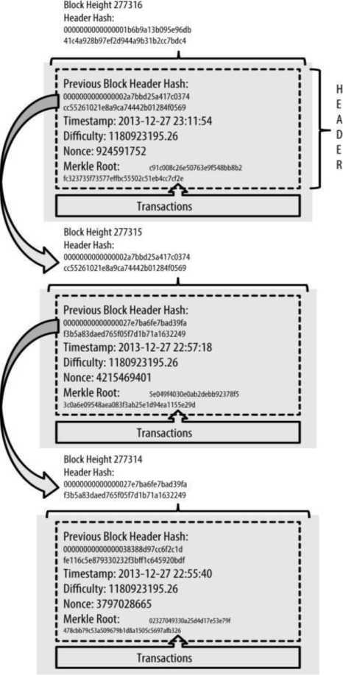

Slide 9
IV. RESULT
As a result, it becomes more difficult to obtain the hash as the reliability coefficient increases. Algorithms determine how many '0' the reliability coefficient starts. Valid is quite difficult to create a hash. In order to determine whether Block is valid or not, when we put the value of nonce with other hash values, a hash of '0' is obtained.
Hash value, which is produced in our hands by the end of our block must be included in the next block:
} aR Problems | @ Javadoc ||j^ Declaration Search | 5 Console | ~
'terminated POWTest [Java Application] CVProgram FHe5\JavaVre1.8»0_191\bin\javaw»exe [22 May 2019 00:01:48)
"nonce": 7328699
},
{
"hash": "000002d780a66e97236ff6f68f677del6d86b3ec5caf9105e7b4e4efd4b9c3c7", "previousHash": "0000072abeed7e96363392d62374c6d31922c4f4ed52f648a80f41ab4576108c^{n}, "data": "Yo ini the second block",
"timeStamp": 1558472528898,
"nonce": 160963
},
{
"hash": "000009409b31edeef0de22cbe6de36306096e35049f012c3ffe33cae9d68a0bb", "previousHash": "000002d780a66e97236ff6f68f677del6d86b3ec5caf9105e7b4e4efd4b9c3c7", "data": "Hey im the third block",
"timeStamp": 1558472529463,
"nonce": 1588590
},

Slide 10
Advantages and Disadvantages:
- It has been tested in a real environment and is still stable today.
- It is slow.
- It consumes a lot of energy and has harmful effects for nature.
- It is sensitive to changeable economies.
Used by: Litecoin, Bitcoin, Dogecoin, Ethereum, etc.
Genre: Competitive consensus.
POW is not a new idea, but Satoshi's compatibility with these and other existing concepts (cryptographic signatures, mixed chains and P2P networks) was a highly innovative fit for a valid distributed consensus system, where the cryptocurrency was the first and basic application.
It creates a distributed and reliable consensus. It is the first consensus algorithm to solve the double spending problem.
What does blockchain miners do should solve a confusing but not calculable calculation problem to add a block of transactions to the blockchain.
It is mainly done to ensure that miners put some money / resources to do the job. It does not adversely affect the blockchain system. It causes them to lose their investments.
The problem we will face here; The run time can be changed to ensure constant block time. There is a situation where multiple miners solve the problem at the same time. In this case, miners choose one of the chains.
The longest chain is considered the winner. Assuming that most miners are working on the same chain; the longest and most reliable person grows fastest.

Slide 11
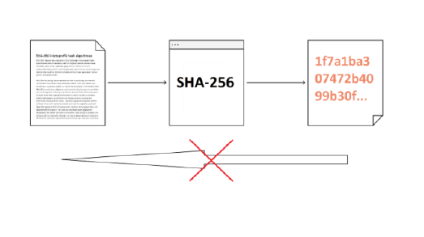
IV. IMPLEMENTATION OF CONSENSUS ALGORITHMS IN BLOCKCHAIN
Realization of the Software:
Software console application interface is shown as Figure 1; main class and exception interface is shown as Figure 2; add our blocks to the blockchain arrayList and source code interface is shown as Figure 3; main functions of blockchain hash control and block creation is shown as Figure 4-5.

Slide 12
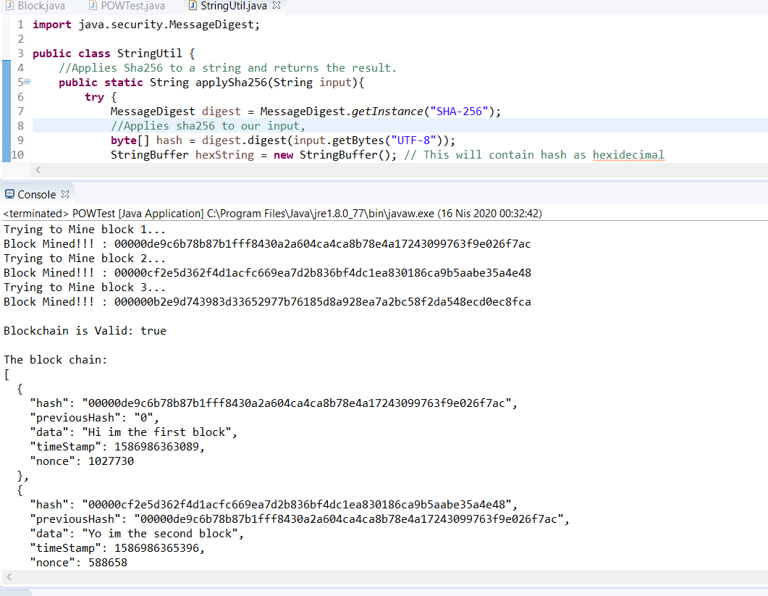
Figure 1: Software Console Application Interface

Slide 13
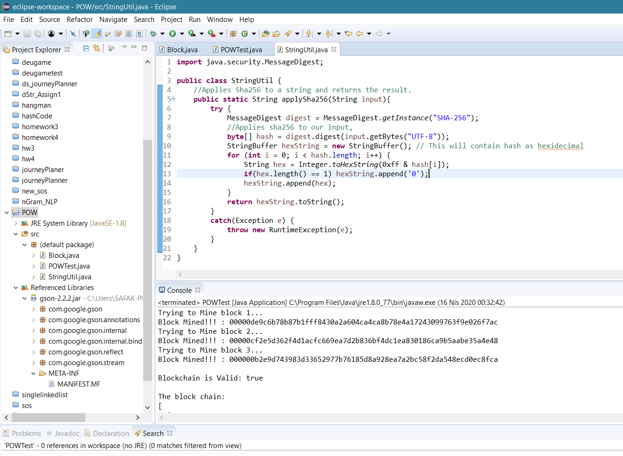
Figure 2: Main Class and Exception Interface

Slide 14
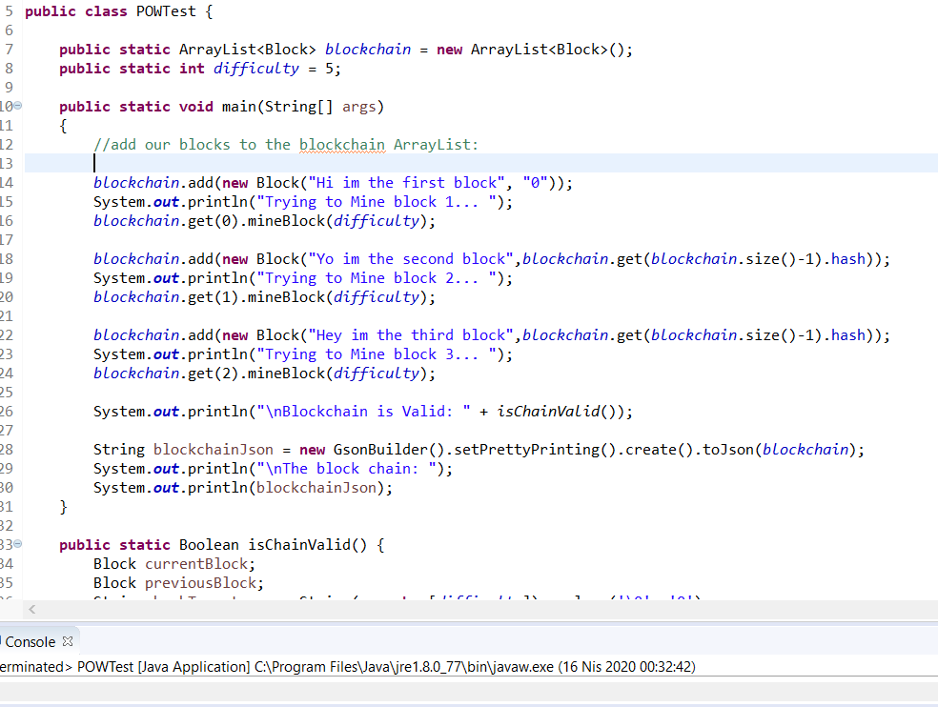
Figure 3: Add Our Blocks to the Blockchain ArrayList –
Source Code Interface

Slide 15
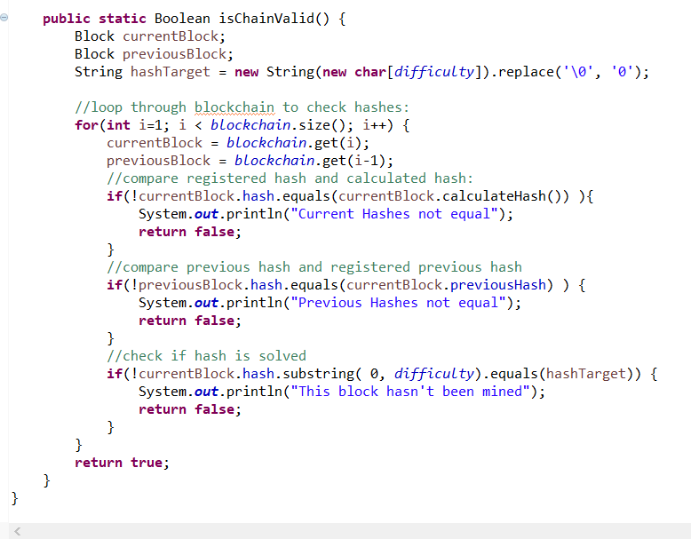
Figure 4: Functions of Blockchain Hash Control

Slide 16
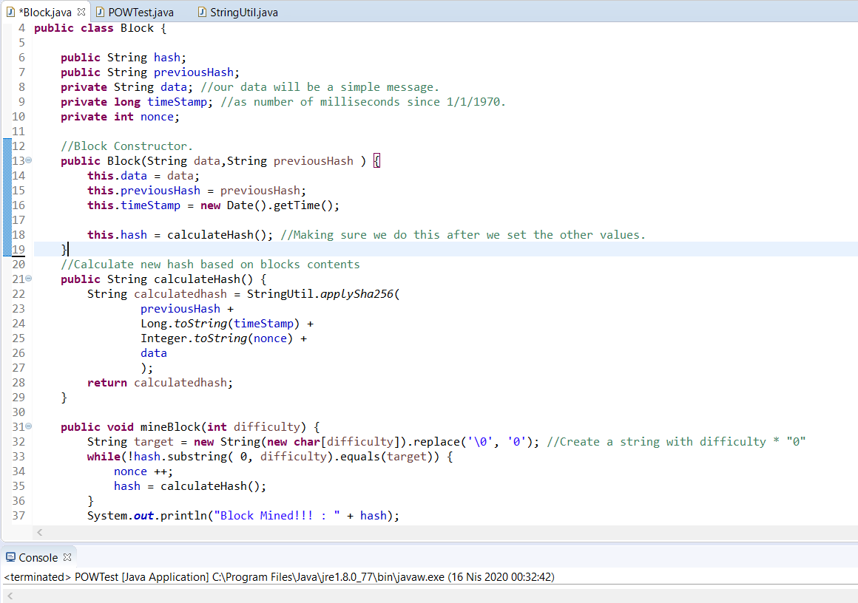
Figure 5: Main Functions and Block Creation

Slide 17
V. REFERENCES
[1] Bitcoin: A Peer-to-Peer Electronic Cash System Satoshi Nakamoto, October 31,2008
[2] Blockchain Challenges and Opportunities A Survey Int. J. Web and Grid Services
[3] An (Almost) Constant-Effort Solution-Verification Proof-of-Work Protocol Based on Merkle Trees Fabien Coelho CRI, Ecole des mines de Paris, ' 35, rue Saint-Honor'e, 77305 Fontainebleau cedex, France
[4] Cuckoo Cycle: a memory-hard proof-of-work system John Tromp, February 1,2014
[5] Verification of a Cryptographic Primitive: SHA-256 ANDREW W. APPEL, Princeton University, August 1,2
[6] Dwork, Cynthia and Naor, Moni “Pricing via processing or combatting junk mail”. Annual International Cryptology Conference, 139-147, 1992.
[7] Douceur, J. R. “The sybil attack”. In International workshop on peer-to-peer systems (pp. 251-260), 2002.
[3] Bentov, Iddo and Lee, Charles and Mizrahi, Alex and Rosenfeld, Meni “Proof of Activity: Extending Bitcoin’s Proof of Work via Proof of Stake [Extended Abstract]”. SIGMETRICS Perform. Eval. Rev., Volume 43, issue 3.
[9] Andrew Miller, Yu Xia, Kyle Croman, Elaine Shi, and Dawn Song. “The Honey Badger of BFT Protocols.” In Proceedings of the 2016 ACM SIGSAC Conference on Computer and Communications Security (CCS ’16). ACM, New York, NY, USA, 31-42. DOI: https://doi.Org/10.1145/2976749.297839

Slide 18
THANK YOU!

